Slide 1
Intro to Computational Statistics
Day 1: Introduction and Setting Up

Slide 3
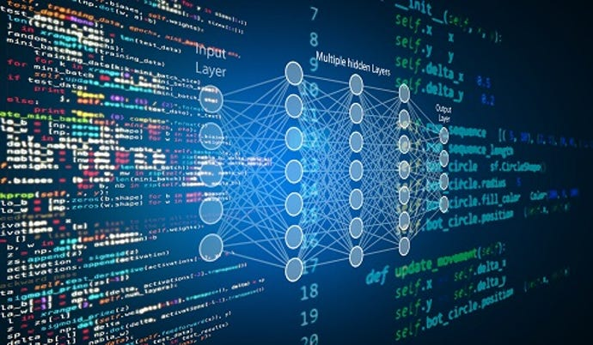

Slide 5
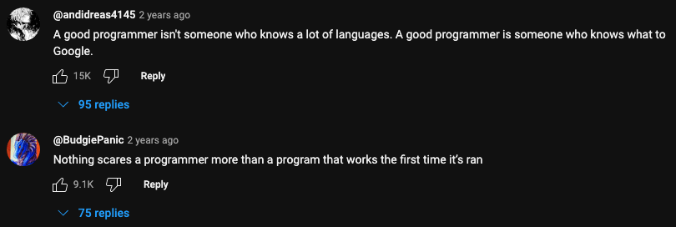

Slide 6
Expectation

Slide 7
Reality

Slide 10
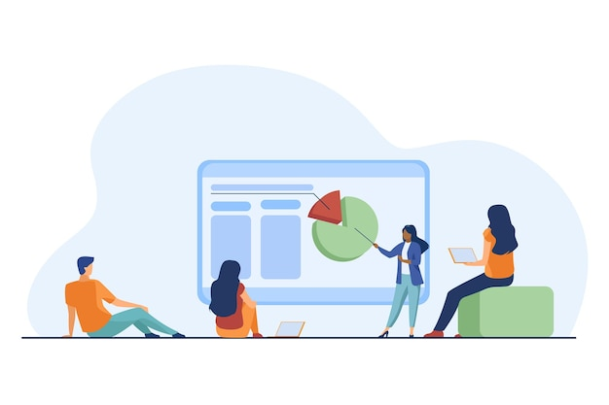

Slide 11
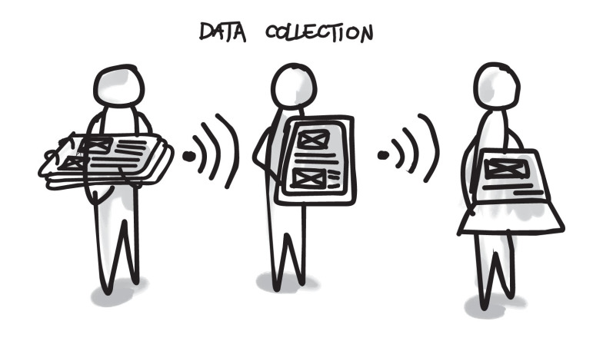

Slide 13
What is computational statistics?

Slide 14
Let’s make a word cloud!
Statistics
Computer Science
Notes:
https://www.menti.com/bli62fntbwde

Slide 15
Computational Statistics is…
Combining the ideas from statistics and computer science to solve bigger problems

Slide 18
Computational Statistics is also…
Being able to communicate your results to a larger audience

Slide 19
Computational Statistics is also…
Being able to communicate your results to a larger audience
Unfortunately, this is often overlooked!!!

Slide 21
The Scientific Process

Slide 22
Question: What is the first step for conducting a scientific experiment?

Slide 23
What is the first step for conducting a scientific experiment?
Notice how few, if any, of the answers were ”knowing how to do the experiment”

Slide 24
Question: Let’s say that you came up with an experiment you know how to run. What do you do?

Slide 25
Let’s say that you came up with an experiment you know how to run. What do you do?
Collect data/observations!

Slide 26
Question: What do you do with the data/observations you collected?

Slide 27
What do you do with the data/observations you collected?
You analyze it and make discussions/conclusions!

Slide 28
In computational statistics, our goal is to…
Define a problem we want to solve

Slide 29
In computational statistics, our goal is to…
Define a problem we want to solve
Gather data that is relevant to the problem

Slide 30
In computational statistics, our goal is to…
Define a problem we want to solve
Gather data that is relevant to the problem
Analyze data to come up with a discussion/conclusion

Slide 31
In computational statistics, our goal is to…
Define a problem we want to solve
Gather data that is relevant to the problem
Analyze data to come up with a discussion/conclusion
Publish findings for others to learn about

Slide 32
In computational statistics, our goal is to…
Define a problem we want to solve
Gather data that is relevant to the problem
Analyze data to come up with a discussion/conclusion
Publish findings for others to learn about
What is the difference between discussion and conclusion?

Slide 33
In computational statistics, our goal is to…
Define a problem we want to solve
Gather data that is relevant to the problem
Analyze data to come up with a discussion/conclusion
Publish findings for others to learn about
What is the difference between discussion and conclusion?
The discussion is where you interpret the results (i.e. put some actual meaning behind the numbers)

Slide 34
In computational statistics, our goal is to…
Define a problem we want to solve
Gather data that is relevant to the problem
Analyze data to come up with a discussion/conclusion
Publish findings for others to learn about
What is the difference between discussion and conclusion?
The discussion is where you interpret the results (i.e. put some actual meaning behind the numbers)
The conclusion is where you summarize the results and call-to-action (i.e. promote further research)

Slide 35
Practice Problem:
What is there to interpret from the figures on the right?
What details make the figures reliable? Unreliable?
If you could take a single message from this image, what would it be?

Slide 36
What is there to interpret from the figures on the right?

Slide 37
What details make the figures reliable? Unreliable?

Slide 38
If you could take a single message from the image, what would it be?

Slide 39
How do I get started?

Slide 40
Is this class right for me?
Writing background (most important)
Analysis
Scientific process/reports

Slide 41
Is this class right for me?
Writing background (most important)
Analysis
Scientific process/reports
Statistics background (important)
Computing mean, variance, and standard deviation
Central limit theorem
Confidence intervals

Slide 42
Is this class right for me?
Writing background (most important)
Analysis
Scientific process/reports
Statistics background (important)
Computing mean, variance, and standard deviation
Central limit theorem
Confidence intervals
Programming background (useful)
Arrays/Lists
For loops
Plotting
Basic computations (e.g. running sum)
Python

Slide 43
Is this class right for me?
Writing background (most important)
Analysis
Scientific process/reports
Statistics background (important)
Computing mean, variance, and standard deviation
Central limit theorem
Confidence intervals
Programming background (useful)
Arrays/Lists
For loops
Plotting
Basic computations (e.g. running sum)
Python
Knowledge of computational methods (not important)
Least useful, so I put this bullet point so that every section has one

